Slide 1
Sessions 6
Block cipher principles
Feistel cipher

Slide 2
Block vs Stream Ciphers
Block ciphers processes messages in blocks.
Example: playfair, hill cipher, DES, AES
Stream ciphers process messages a bit at a time.
Example: Vernam cipher, OneTime Pad

Slide 3
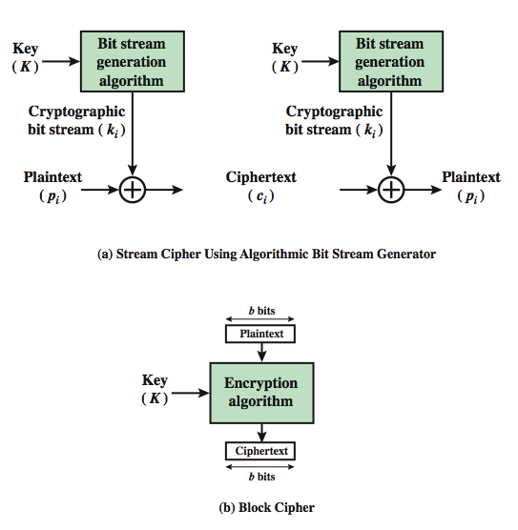
Block vs Stream Ciphers

Slide 4
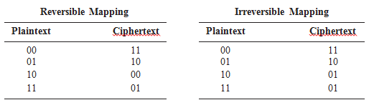
The encryption of a block cipher should be reversible or singular so that decryption is unique

Slide 5
Block Cipher Principles
Most symmetric block ciphers are based on a Feistel Cipher Structure
It is needed because we can be able to decrypt ciphertext to recover plaintext efficiently
Block ciphers look like large number of substitutions

Slide 6

Ideal Block Cipher
permutation

Slide 7
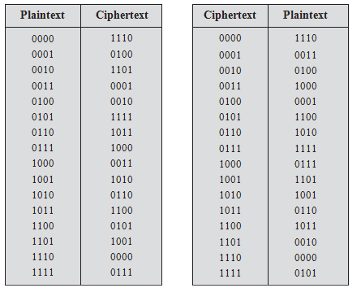
Encryption & Decryption for ideal block cipher

Slide 8
Claude Shannon
Claude Shannon in 1949 introduced the idea of substitution-permutation (S-P) networks.
Substitution ( S Box) : Each plaintext element or group of elements is uniquely replaced by a corresponding ciphertext element or group of elements.
Permutation (P Box) : A sequence of plaintext elements is replaced by a permutation of that sequence. That is, no elements are added or deleted or replaced in the sequence, rather the order in which the elements appear in the sequence is changed.
provide confusion & diffusion of message & key

Slide 9
Confusion and Diffusion
Confusion – Makes relationship between ciphertext and key as complex as possible.
Diffusion – Each plaintext digit affect the value of many ciphertext digits.

Slide 10
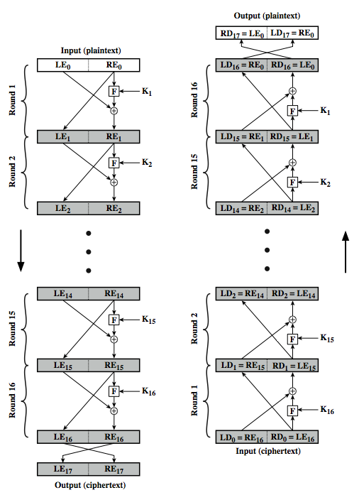
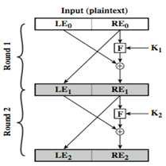
Feistel Cipher Structure

Slide 11
Feistel Cipher Structure
Partitions input block into two halves
  Process through multiple rounds which
  Right half goes to left directly
  Right half and key pass through a function F, its output is xored with left half. This total result comes to right
  After a number of rounds left and right halves are swapped
Implements Shannon’s S-P network concept

Slide 12
Feistel Cipher Design Elements
block size
key size
number of rounds
sub-key generation algorithm
Function, F
fast software encryption/decryption
ease of analysis

